Slide 1

Solas Eatz
Empowering Family-owned Restaurants and Cafes through Community & Offers

Slide 2
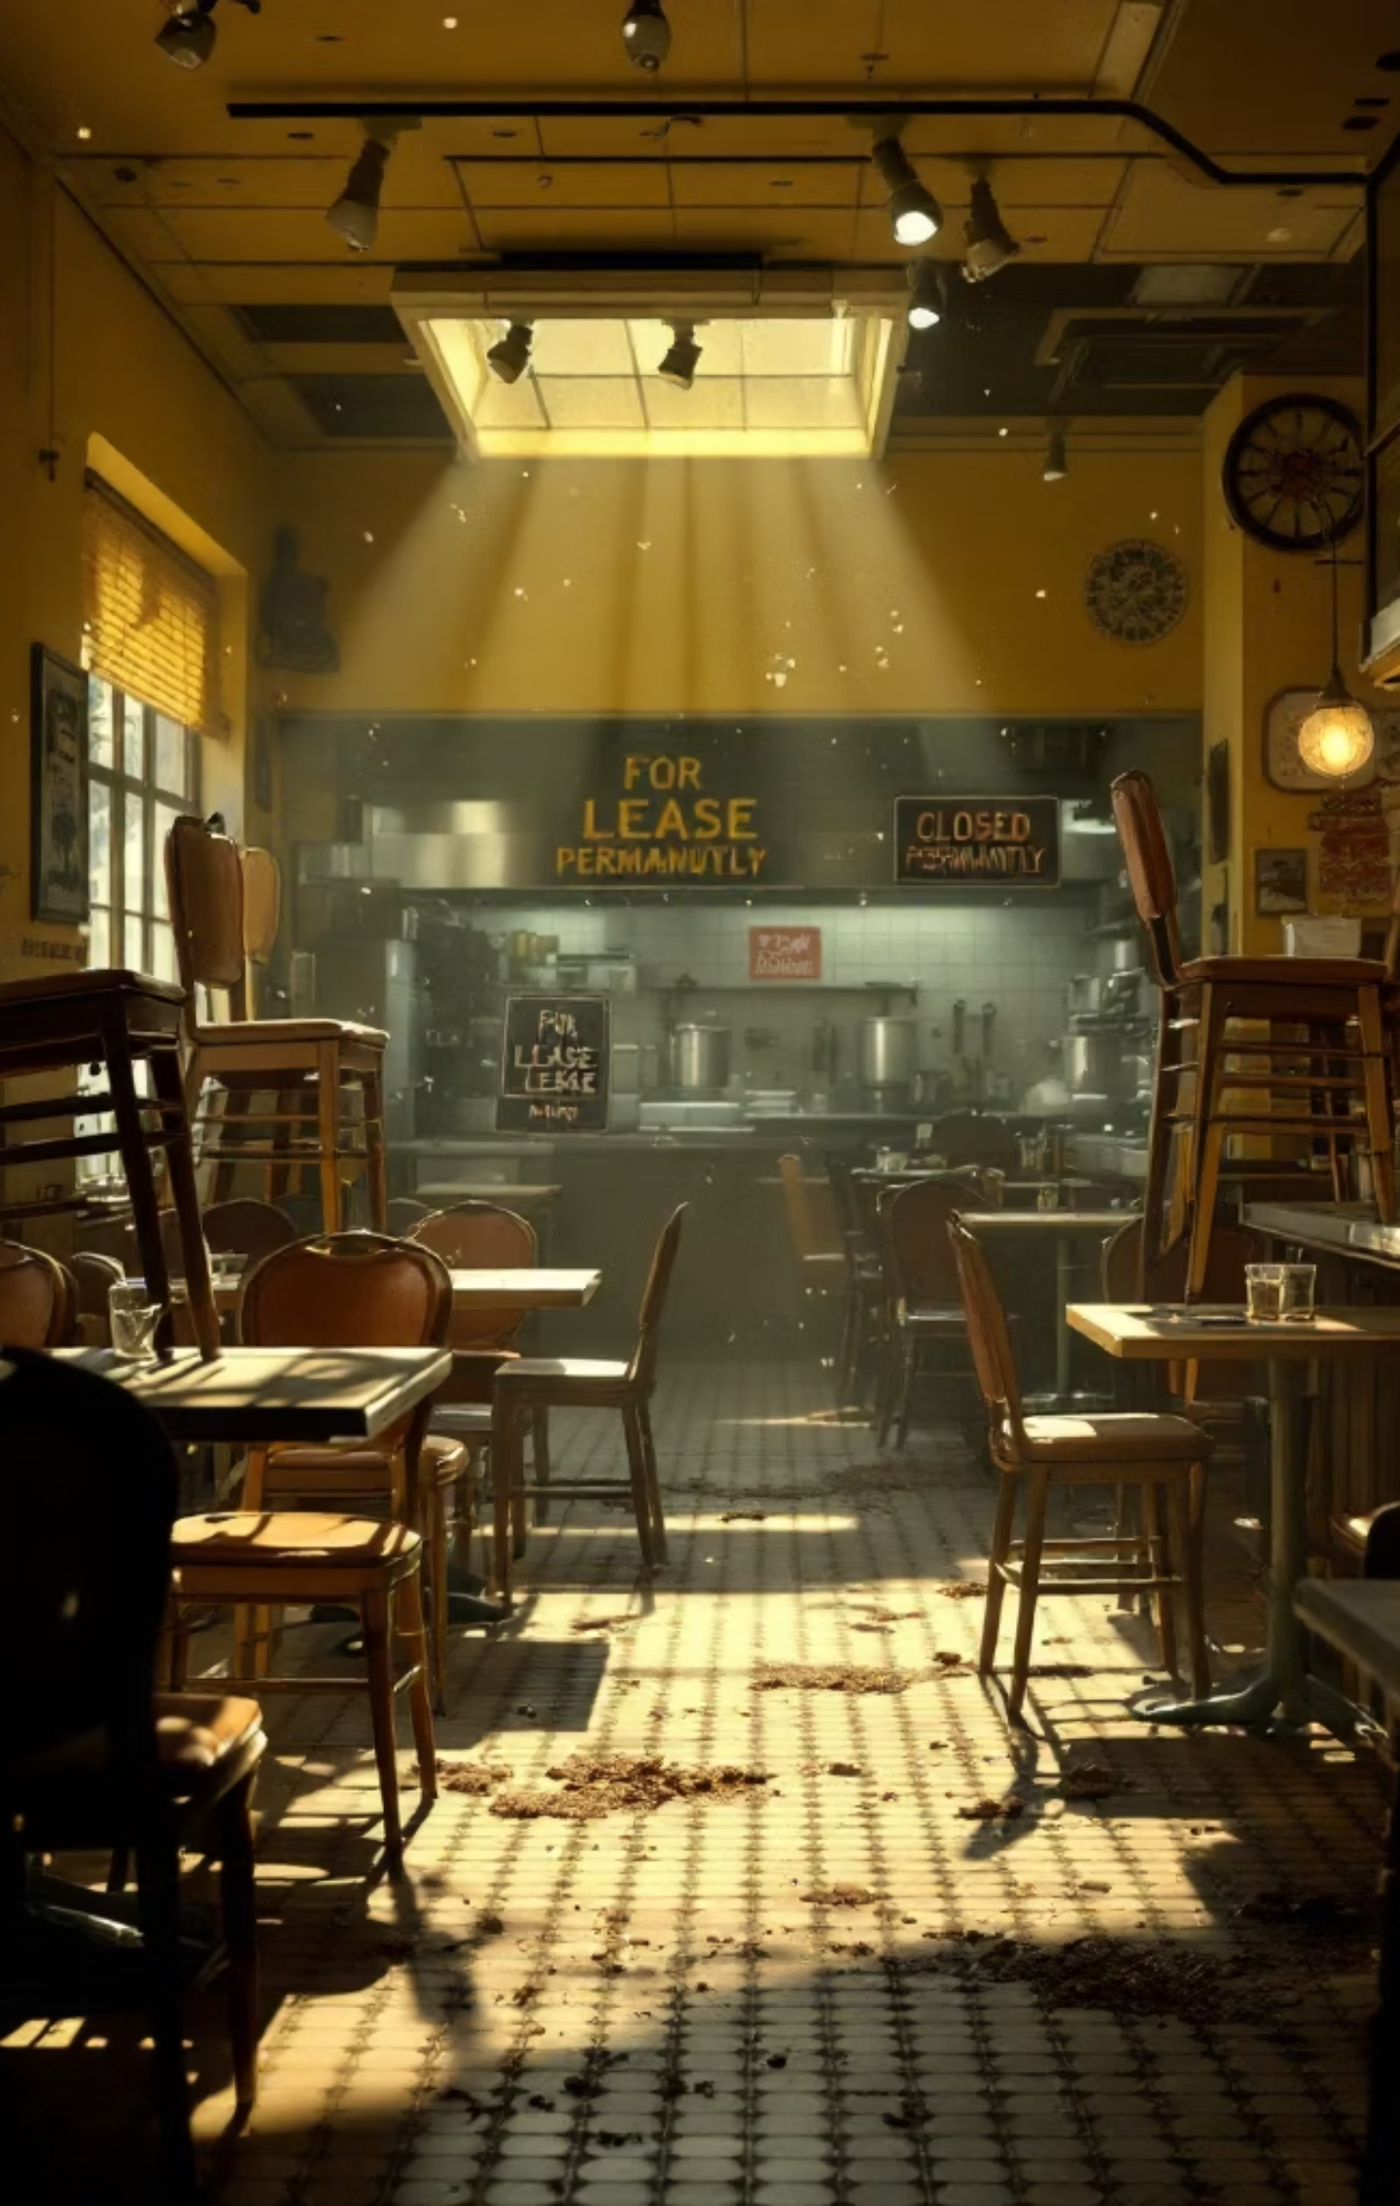
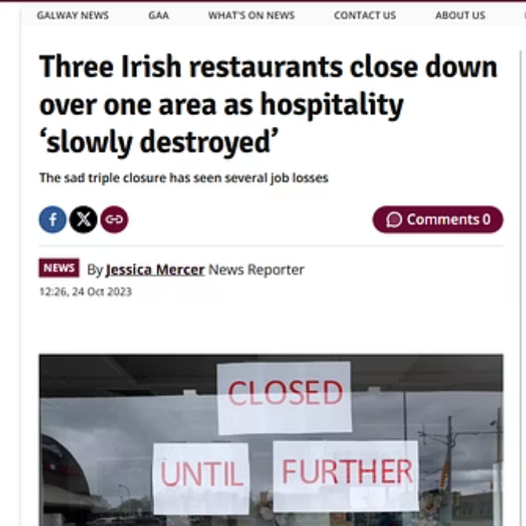
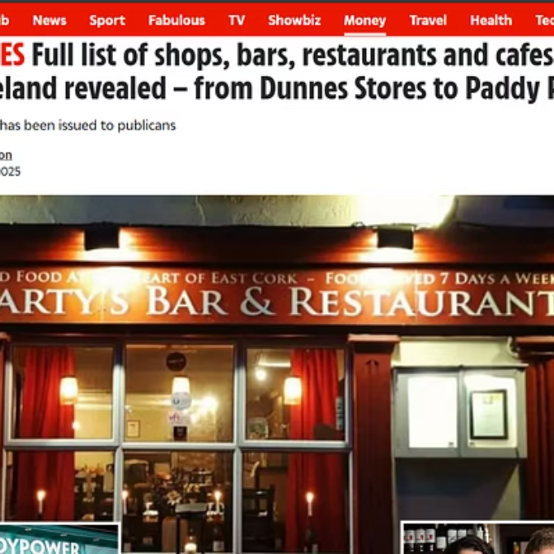
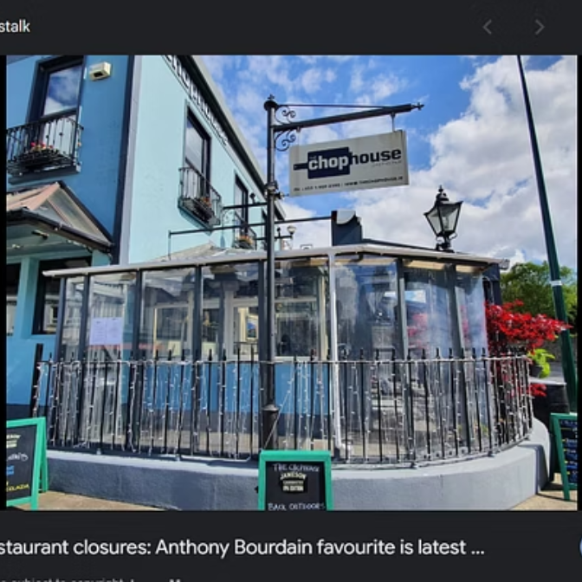
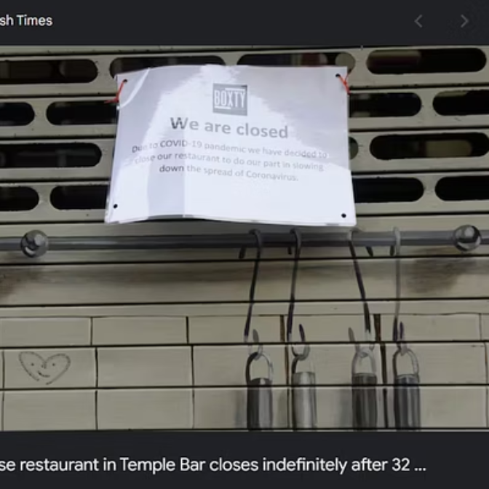
The Restaurant Crisis
1,600+
34%
13.5%
Restaurant Closurez
Increase in Food Costz
Increase in VAT

Slide 3
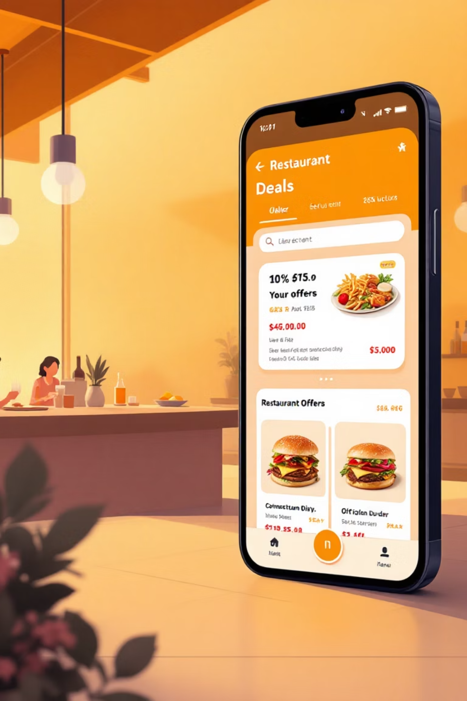




Introducing Solas Eatz
A Hyperlocal Discovery & Rewards Platform
Post Exclusive Dealz and offerz
Direct Customer Relationship Building
Discover Hidden Gemz
Loyalty Rewardz

Slide 4

How We Integrate Solana
Wallet-Based Login
Paymentz
Reviewz and Feedbackz(POH)
Digital Coupons using NFTz

Slide 5

Market Opportunity
€6.5B
>5k
Ireland Restaurant Market
Restaurants and cafes currently operating
€2.2B
38%
Amount spent by Irish Customerz on food
Approximate number venuez using special offerz to attract dinerz

Slide 6
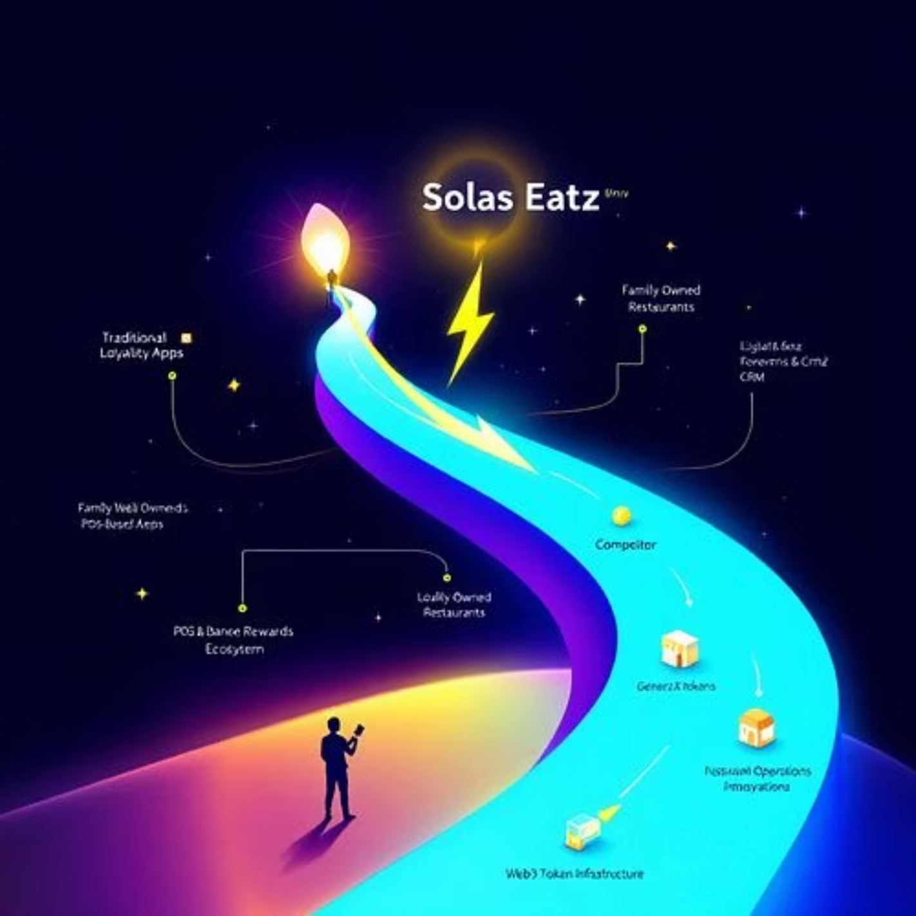
Competitive Advantage
Solas Eatz: Leading the Future of Restaurant Discovery & Loyalty

Slide 7



Revenue Model
Advertising
Sponsored Listingz
Premium Paid Featurez
2
1
3

Slide 8
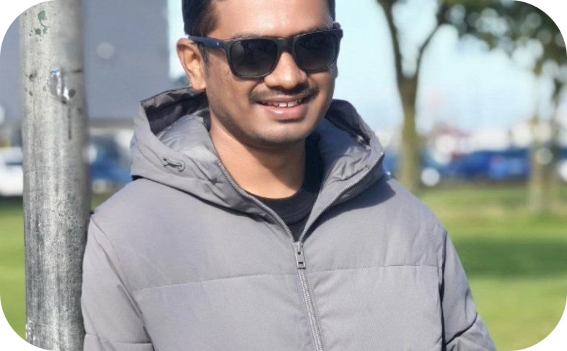
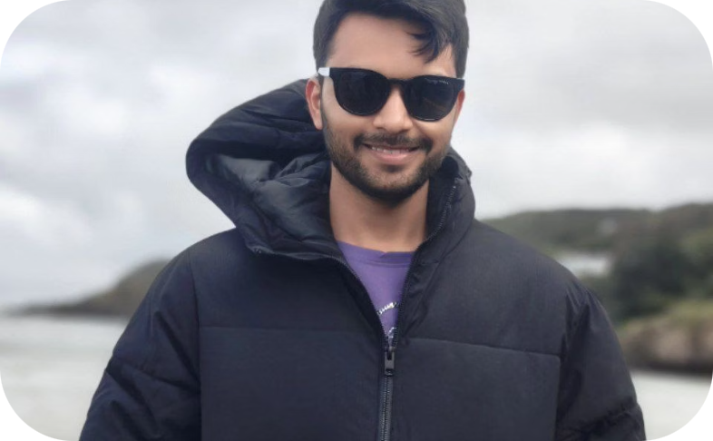
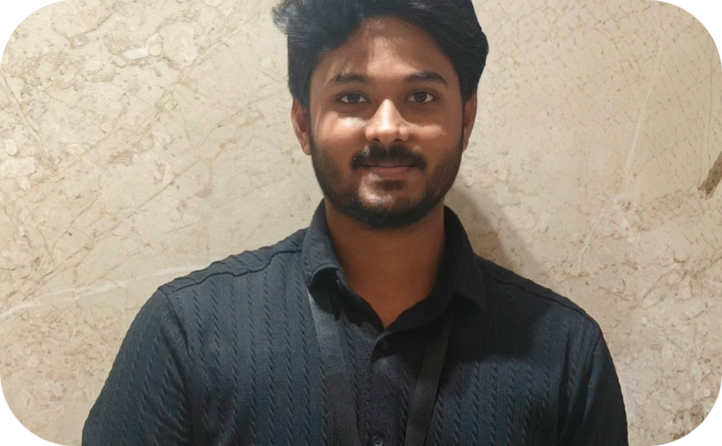
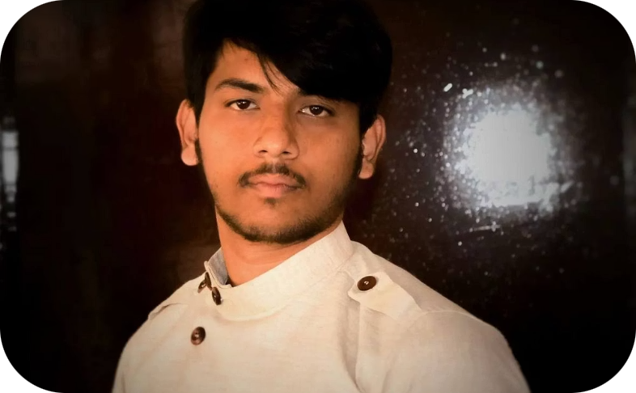
Meet The Team
Balaji Segu Krishnaiah
Akarsh N Lakshmisha
Sai Shreyas Gubbi Harish
Tejas Shiv
Kumar
MSc in AI (DCU)
MSc in AI (DCU)
MSc in Cloud (NCI)
MSc in DA (DCU)
Previously at McKinsey & Tejas Networks
Previously at
Previously at Ernst & Young (EY)
Previously at AceMicromatic
Yellow.Ai
skbalajimbl1@gmail.com
akarshnl17@gmail.com
ghsaishreyas3@gmail.com
tejas.shivkumr@gmail.com

Slide 9
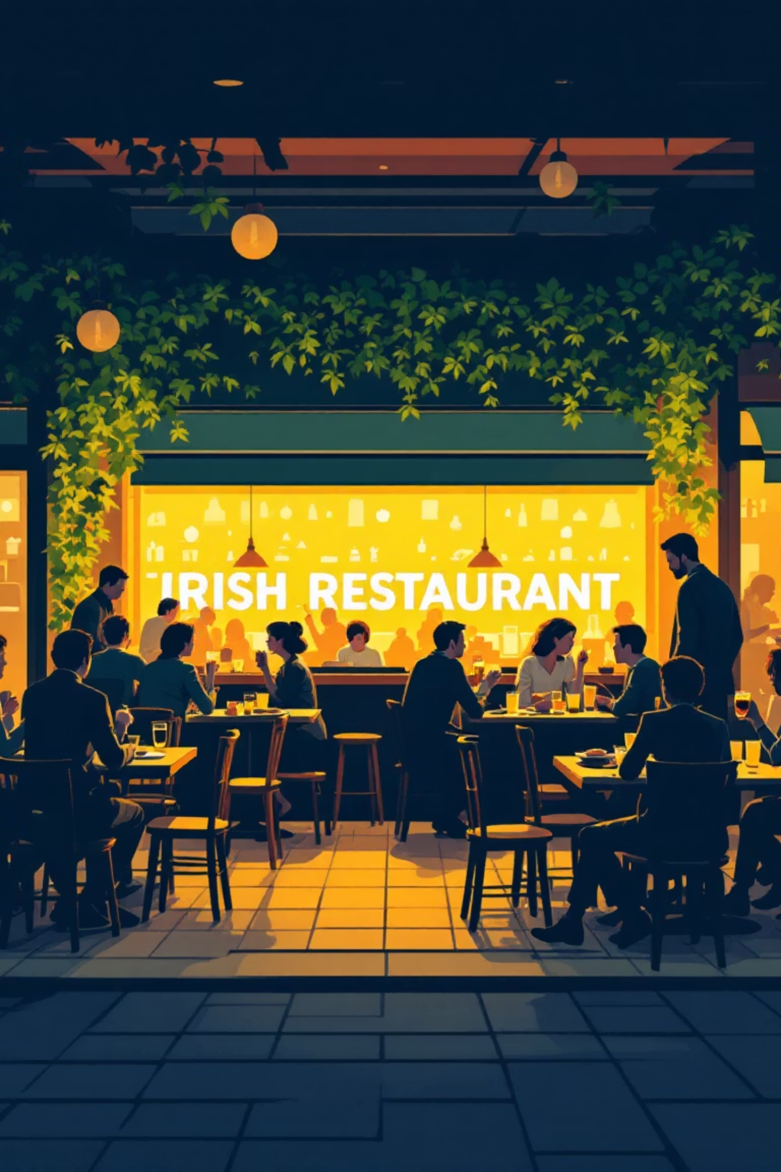
Thank You!

